Slide 1
IBM University Engagement Project Submission

Slide 2
Project Tile – Travel Planner Agent
Domain of Project – Travel & Tourism
Student Name | Recent Passport Photo | Email ID | Mobile number [WhatsApp]
MANOJ BADIGINTI |  | manojbadiginti2@gmail.com | 8185079095

Slide 3
Problem Statement -
Problem Statement: Travel Planner Agent
The Challenge
Travel planning can be time-consuming and confusing. Users need to search multiple websites for destinations, hotels, transportation, weather information, and travel tips. This process often results in poor planning and missed opportunities.
The Objective
Build an AI-powered Travel Planner Agent that:
Creates personalized travel itineraries
Recommends hotels and accommodations
Suggests transportation options
Provides travel tips and local attractions
Understands user preferences and budgets
Delivers travel guidance through natural conversations

Slide 4
Technology Used
Tech Stack (Mandatory)
Use any one of the following approaches:
LangFlow + IBM watsonx.ai + Granite Models
IBM Cloud Agentic Lab with IBM Granite Models
Replicate with LangChain + RAG + IBM Granite Models
I used IBM watsonx.ai + watsonx Orchestrate-p7

Slide 5
Proposed Solution -
Our proposed solution is Travel Planner Agent AI, an AI-powered Travel Planner Agent developed using IBM watsonx.ai, IBM Granite Models, IBM watsonx Orchestrate, and IBM Cloud Lite Services
The main objective of this project is to simplify travel planning and provide users with personalized travel recommendations through a conversational AI interface.
The agent interacts with users and collects important information such as destination, budget, trip duration, and travel preferences. Based on these inputs, the IBM Granite model analyzes the requirements and generates customized travel itineraries.
The system also recommends suitable hotels, transportation options, tourist attractions, and useful travel tips. Users can simply chat with the agent in natural language, making the travel planning process easier and more user-friendly.
IBM watsonx Orchestrate is used to build and manage the Travel Planner Agent, while IBM Granite Models provide the intelligence required to understand user queries and generate personalized responses.
Overall, Travel Planner Agent AI acts as a smart travel companion that helps users save time, make informed decisions, and enjoy a seamless travel planning experience.

Slide 6
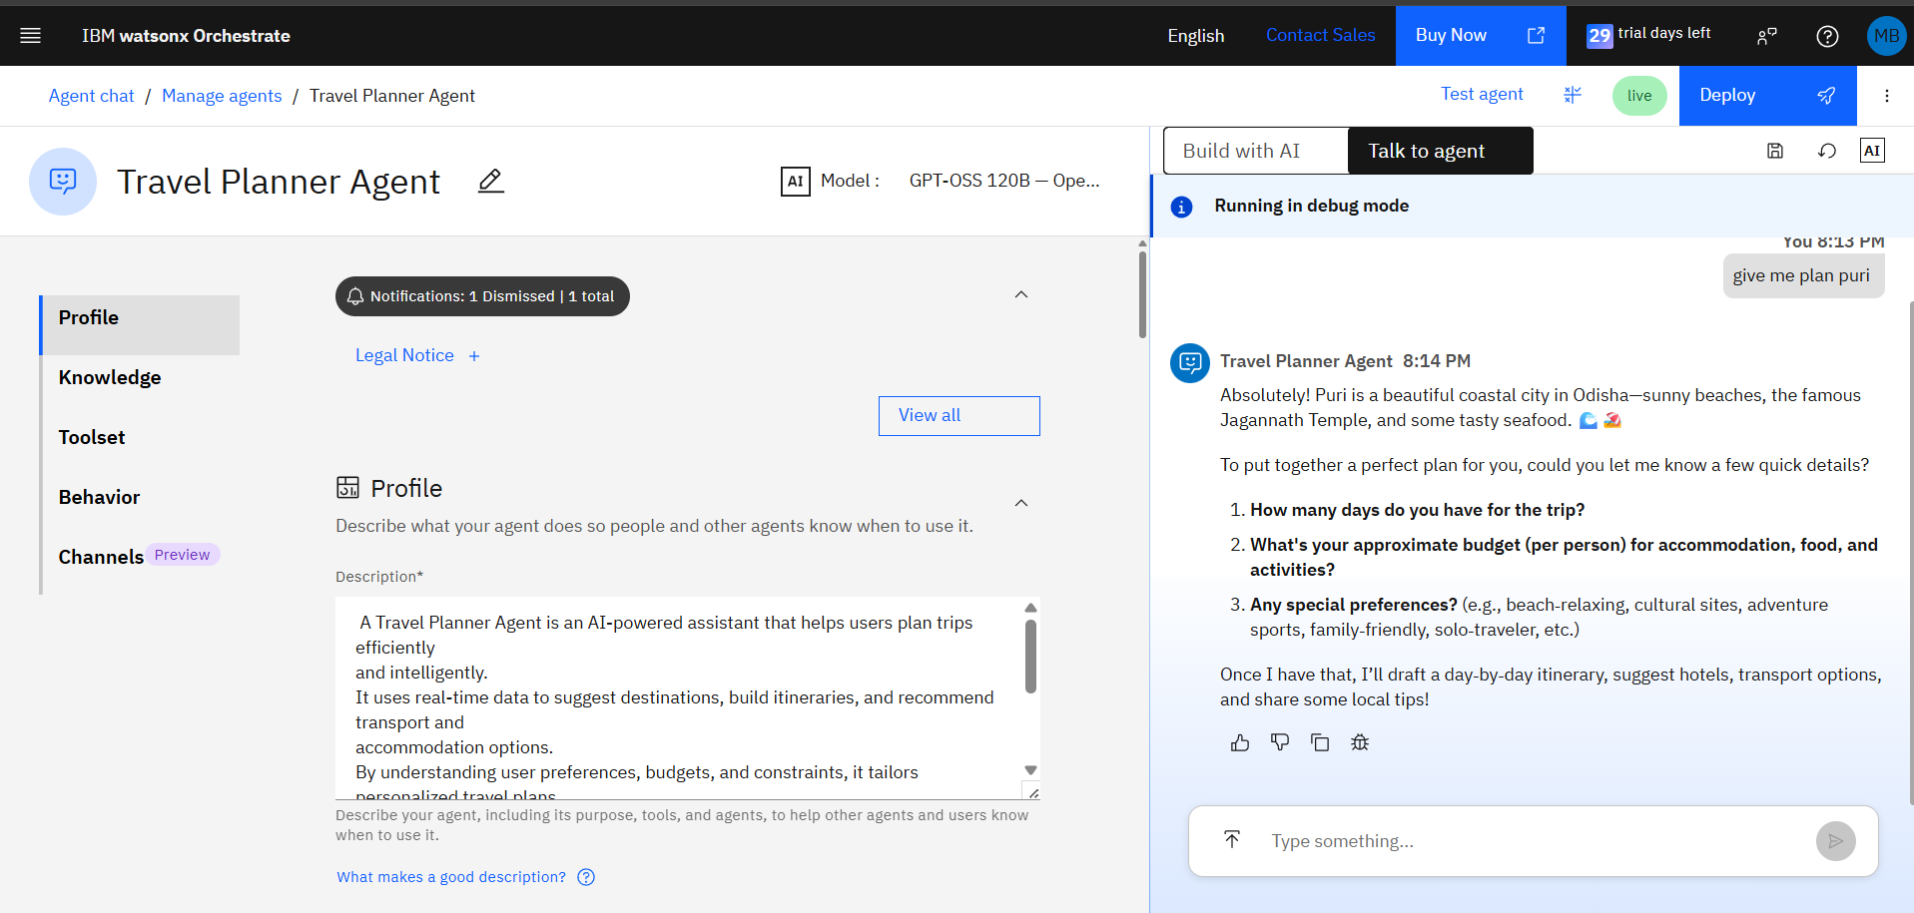
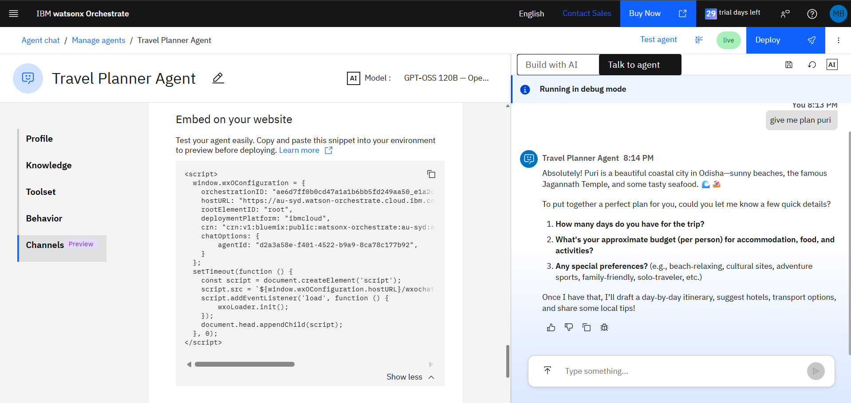

Slide 7
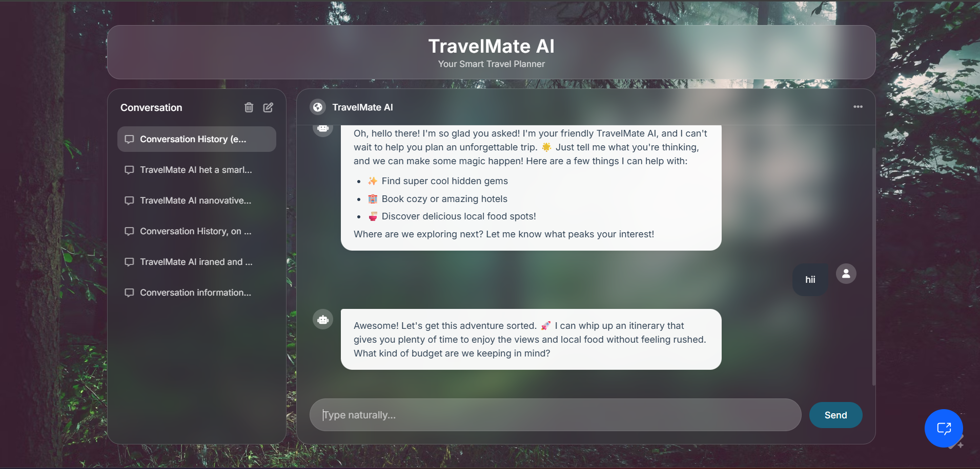
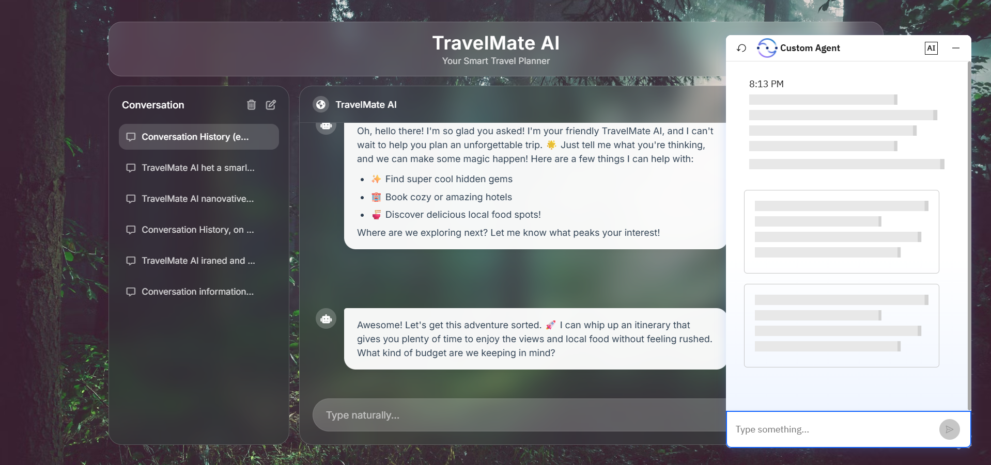

Slide 8
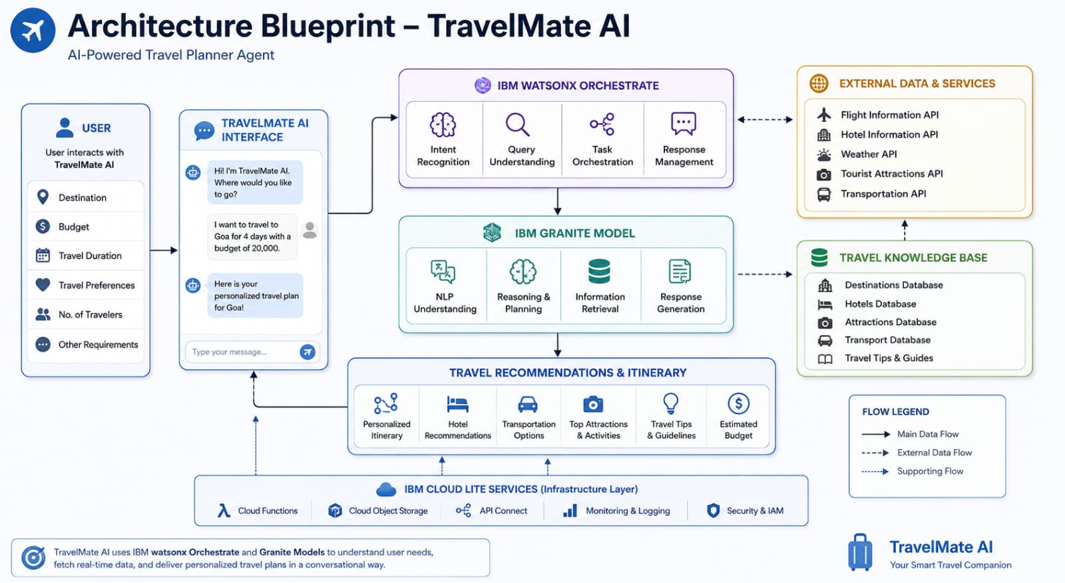
Architecture blueprint

Slide 9
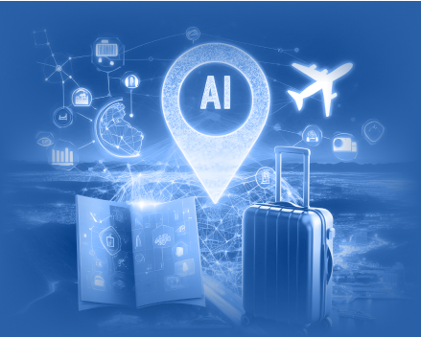
Role of Agentic AI in the solution
Role of agentic AI in travel planner agent
Agentic AI transforms the application from a passive, script-based chatbot into an active, autonomous assistant that can independently break down a complex, multi-day travel request into distinct operational sub-tasks like routing, budgeting, and scheduling without needing constant manual direction. This process is driven by multi-agent collaboration, where specialized, independent micro-agents—such as a City Selection Agent and a Local Concierge Agent—work together and fluidly share data behind the scenes to construct a unified, seamless itinerary. Throughout the interaction, the system maintains dynamic context retention by keeping an active memory of the traveler's specific budget, personal style, and trip duration constraints, which allows it to instantly update and recalibrate the entire travel plan if the user changes their inputs mid-conversation. Finally, by utilizing the logical reasoning and processing capabilities of the IBM Granite model, the agent performs continuous self-correction and validation to ensure that all recommended travel times, lodging options, and daily activities are realistic, mathematically accurate, and geographically viable before presenting them to the traveler.

Slide 10
Technology Used
IBM Cloud – It provides the infrastructure to build, deploy, and scale the Nutrition Agent efficiently. IBM Cloud enables a reliable, secure, and scalable environment for deploying the Nutrition Agent.
RAG– RAG to fetch real data first, then generate intelligent answers, making the Nutrition Agent more trustworthy and effective.
IBM Watsonx.ai - For model deployment, embeddings, and AI governance
Vector Database (FAISS/Chroma) – For RAG-based nutritional data retrieval

Slide 11
Novelty and Uniqueness
The proposed TravelMate AI – Travel Planner Agent stands out by combining Artificial Intelligence, personalization, and conversational assistance into a single intelligent travel planning solution.
Personalized Travel Planning – Generates customized travel itineraries based on user preferences, budget, travel duration, and interests.
AI-Powered Recommendations – Uses IBM Granite Models to provide intelligent suggestions for destinations, accommodations, transportation, and activities.
Conversational User Experience – Allows users to interact naturally with the system through simple conversations instead of manually searching multiple websites.
Smart Itinerary Generation – Automatically creates day-wise travel plans tailored to the user's requirements.
Budget-Aware Planning – Suggests travel options and accommodations that match the user's budget constraints.
Travel Guidance & Tips – Provides useful travel advice, local attraction recommendations, and destination-specific information.
Scalable and Reliable Solution – Built using IBM watsonx.ai, IBM watsonx Orchestrate, and IBM Cloud Lite Services, ensuring reliability and scalability.
This makes TravelMate AI a smart, personalized, and user-friendly travel assistant that simplifies trip planning and enhances the overall travel experience.

Slide 12
Git Hub Link
· Please create public github repository (Enable Add README button while creating repository) with format –
Please test and Paste the working Github URL –https://github.com/badigintimanoj
Make sure you have Uploaded following three files into your github repository 1) app.json file , 2) yourproblemstatement.pdf file 3) your projectpresntation.pptx file 4)any other files
·
·
·

Slide 13
Future Scope
• Real-Time Travel Integration:
In the future, the Travel Planner Agent can be integrated with real-time weather services, flight booking platforms, hotel reservation systems, and transportation services. This will enable users to receive live updates, compare travel options, and make bookings directly through the AI assistant.
• Advanced Personalized Travel Assistance:
The system can be enhanced with voice interaction, multilingual support, GPS navigation, and AI-based travel recommendations using user history and preferences. This will provide a more personalized, interactive, and seamless travel planning experience for users.
·

Slide 14


